Slide 1
What is next?
Niels Taatgen
Artificial Intelligence

Slide 3
Learning is more successful with prior learning
Two CRT tasks
One CRT task
No prior learning

Slide 4
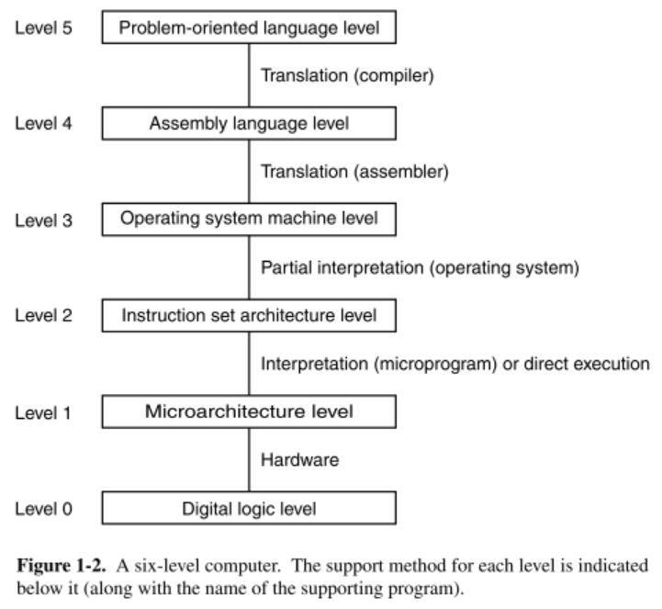
Computer architecture vs. Cognitive Architecture
Notes:
Lower levels are physics, higher levels have “meaning”.

Slide 5
Levels of abstraction for Cognition (Newell)
Time Units | System | World theory
Months |  | Social Band
Weeks
Days
Hours | Task | Rational Band
10 min | Task
minutes | Task
10 sec | Unit Task | Cognitive Band
1 sec | Operations
100 msec | Deliberate act
10 msec | Neural circuit | Biological Band
1 msec | Neuron
100 μsec | Organelle

Slide 6
The cognitive architecture is different from a computer architecture

Slide 7
compilation

Slide 8
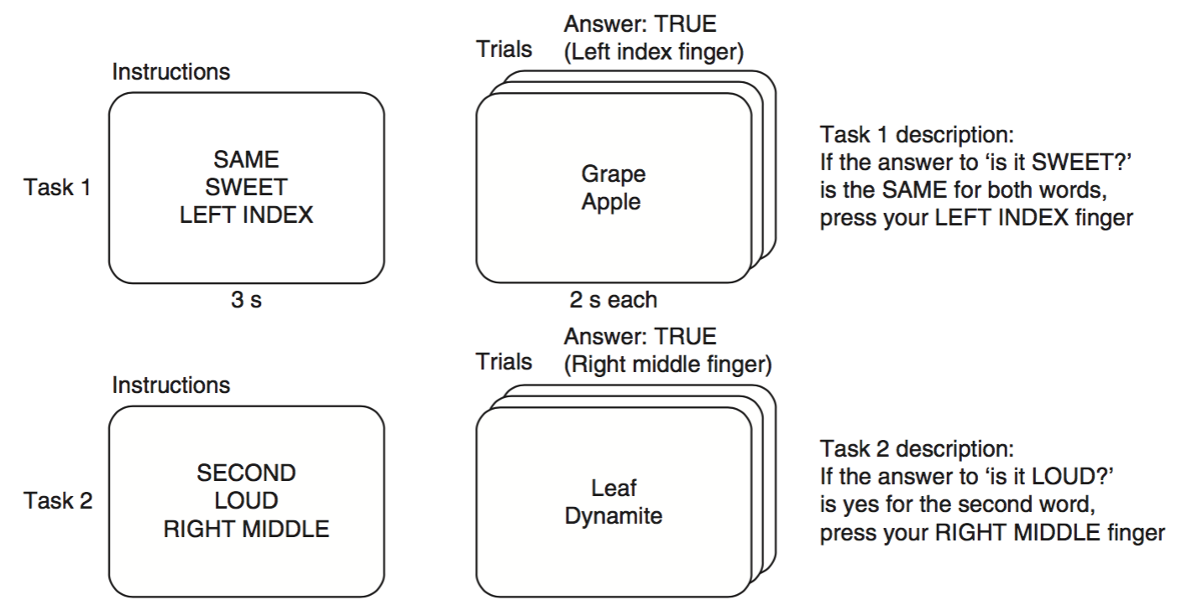
Example: RITL experiment

Slide 9
Just One

Slide 10
Loud

Slide 11
Right Middle

Slide 12
+

Slide 13
Drums
Airplanes

Slide 14
What skills do we need?
Skills for same/justone/second/not second
A skill that tests an attribute that we can instantiate
A skill that pushes buttons that we can instantiate

Slide 15
Implementation

Slide 16
Instantiate those skills
Instantiate-skill(“just-one”,”just-one-1”, [“arg-subskill-1”,”determine-attribute-1”], [“success-skill”,”press-finger-yes”], [“fail-skill”,”press-finger-no”])
Instantiate-skill(“determine-attribute”,”determine-attribute-1”, [“fact-type”, “loud”])
Instantiate-skill(“respond-press”,”press-finger-yes”, [“finger”, “right-middle”])
Instantiate-skill(“respond-press”,”press-finger-no”, [“finger”, “left-middle”])

Slide 17
But these are just chunks that we can also create in the model
just-one-1
isa skill
slot1 just-one
arg-subskill-1 determine-attribute-1
success-skill press-finger-yes
fail-skill press-finger-no
determine-attribute-1
slot1 determine-attribute
fact-type loud
etc.

Slide 18
Full model

Slide 19
The new challenges
Develop the architecture to allow modeling at different levels of abstraction
Develop mechanisms for learning and transfer for each of these levels
Mitigate the parameter-fitting accusation
Build knowledge-rich models by sharing resources

Slide 20
